Slide 1

Knight's Tour
Chaitanya Bhutada : 17CS10011
Sanket Meshram: 17CS30030

Slide 2
Outline
What is Knight's Tour.
Knights Graph.
BackTracking
Algorithm
Complexity Analysis
Example
Heuristics (Warnsdorff's Rule)
Algorithm
Visualization
Complexity Analysis
Example
References
Future Work
Q&A

Slide 3
What is ‘Knight’s Tour?
Hamiltonian Tour of a Chess knight.
Start on a Random Square.
Visit each square exactly once.
Tour can be Open/ Closed just like Hamiltonian.
Variations of knight's tour problem.
Tour on a n*m Board.
Irregular Board possibly with holes.

Slide 4
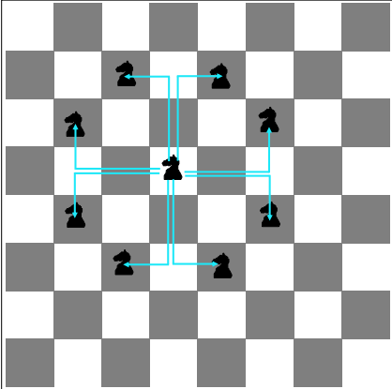
Knights Legal Moves
The Moves can be : {(-2,-1),(-2,+1),(-1,-2),(-1,+2),(+1,-2),(+1,+2),(+2,-1),(+2,+1)}
Corner case: The Knight Cannot Move out of the Chess-Board.

Slide 5
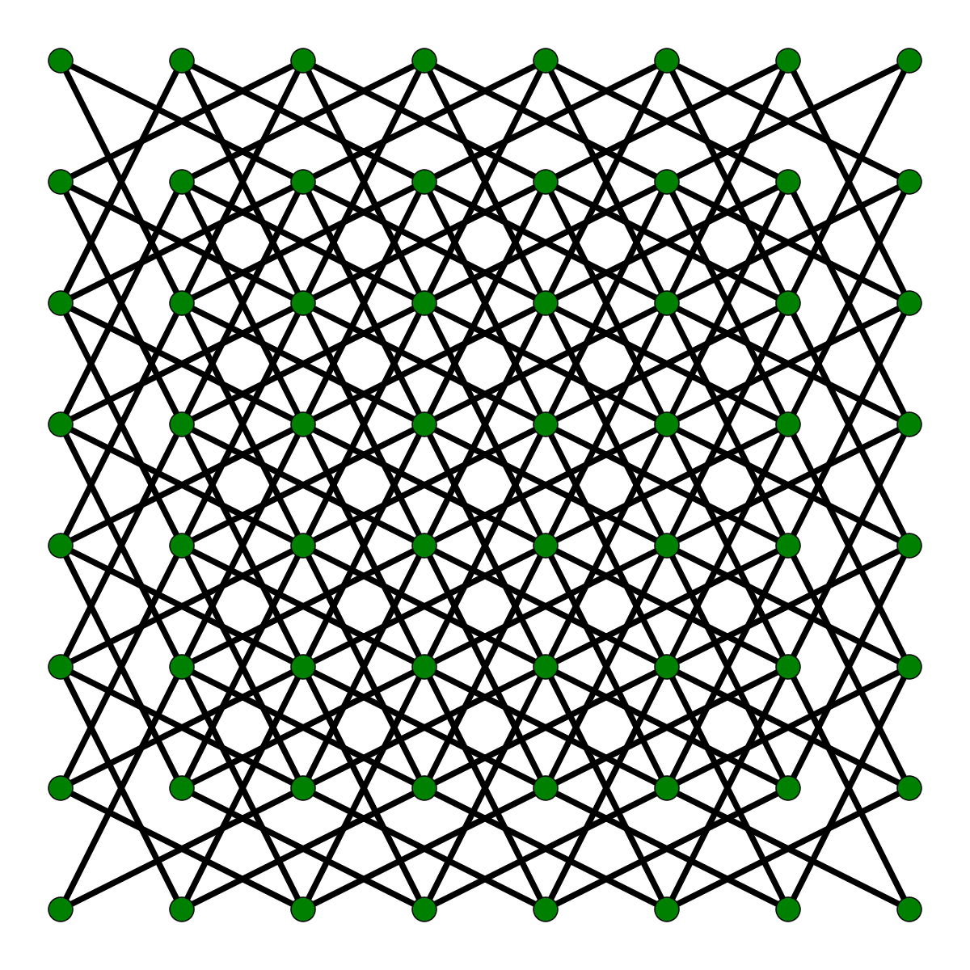
Knight's Graph
Knight's tour can be represented as a Graph.
The vertices - Represent the squares of the board.
The Edges - Represent Legal moves of the knight.
Knight's Graph is Bipartite.
The tour is instance of Hamiltonian Path.
Closed tour is instance of Hamiltonian Cycle.
Can be solved in a linear time using Heuristics.

Slide 6
BackTracking Solution. (Algorithm and Analysis)
Start from a random (X,Y) position on the Chess Board.
Make a move until we reach traverse all 8*8 or n*m positions.
From the Current Position we can move to the next 8 positions.
Mark the Current Position Visited.
Move to next Position and return True if all position is traversed.
If at point we can't move to any free position and get a Possible path return False.

Slide 7
Space and Time Complexity Analysis.
Space Complexity
Marking each position visited or not.
O(n*m) n = number of rows, m = number of columns.
Time Complexity
Each Position can move to at most 8 next positions.
O(8^(n*m))
The Space complexity is linear.
Time complexity is Exponential.
Cannot use this for 8*8.

Slide 8
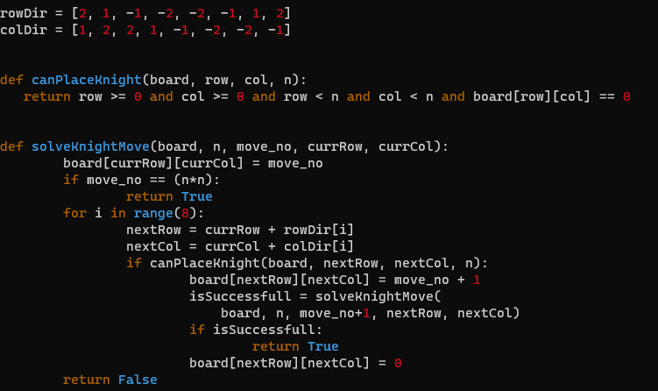
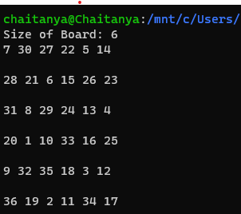
Output for 6*6.
Time taken = 10 mins.

Slide 9
Warnsdorff's Algorithm
Always visiting the Square which has least Accessibility.
Algorithm
set P as any random start Square.
mark P with number '1'
for each move number 2 to (n*m):
Let S be set of points accessible from P.
set P with point of least accessibility.
mark P with current move number.
The marking will return us the order of knights move.

Slide 10
Visualization
'1' is the Start Position.
The number in the boxes denotes the accessibility of that position.
Intuition behind this is that the one's which has lower accessibility would be blocked earlier.
3 |  | 7
 |  |  | 7
 | '1'
 |  |  | 7
2 |  | 5

Slide 11
Space and Time Complexity Analysis.
Space Complexity
Marking each position visited or not.
O(n*m) n = number of rows, m = number of columns.
Time Complexity
From a Position knight can move to one of max 8 positions.
O(8*(n*m))
The Space complexity is linear.
Time complexity is Linear.

Slide 12
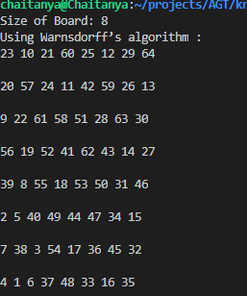
Output for 8*8.
Time taken < 1 sec.

Slide 13
References
1] SAM GANZFRIED
2] https://www.slac.stanford.edu/pubs/slacpubs/0250/slac-pub-0261.pdf
3] http://www.cs.kent.edu/~dragan/ST-Spring2016/Knights%20Tour%20Graphs.pdf

Slide 14
Future Work
1] Ties in Accessibility
2] Divide and Conquer algorithm for knight's tour
3] Neural network solution for knight's tour
4] Magic knight's tour

Slide 15
Q & A

